Slide 1
Experiment 1

Slide 2
Shell A shell is a computer program that allows you to directly control a computer’s operating system (OS) with a graphical user interface (GUI) or command-line interface (CLI). BASH Bash is a command-line interface shell program used extensively in Linux and macOS. The name Bash is an acronym for “Bourne Again Shell,” developed in 1989 as a successor to the Bourne Shell.

Slide 3
Various Commands

Slide 4
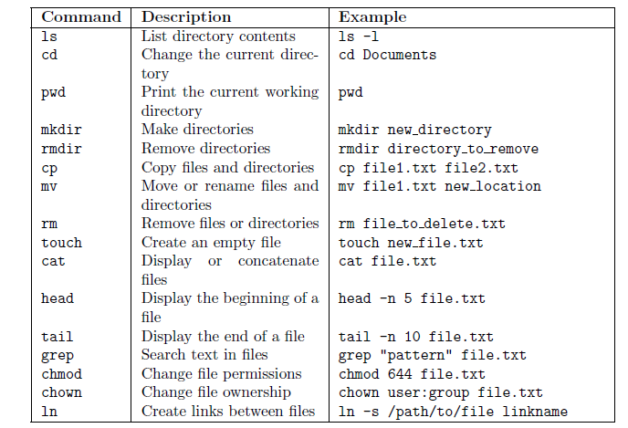

Slide 5
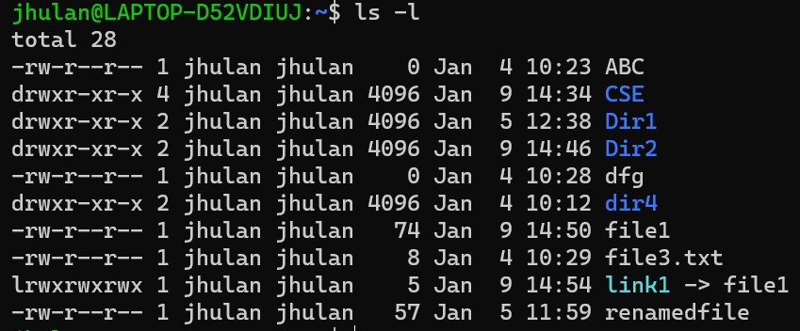
Ls is used to list the names of all the objects that are present in the working directory.

Slide 6
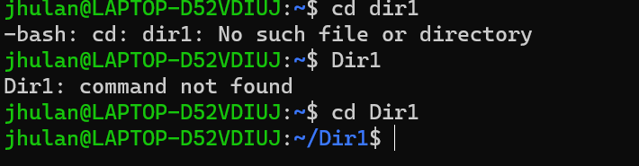
Cd change directory

Slide 7
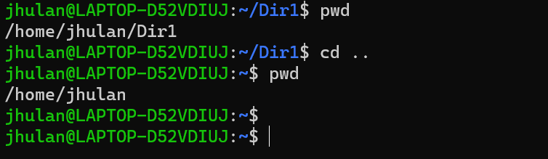
pwd present working directory

Slide 8
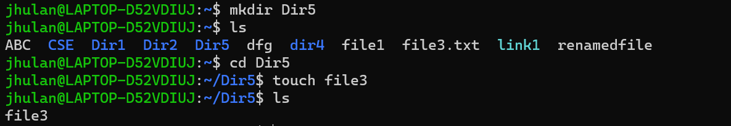
mkdir it helps to make a directory

Slide 9
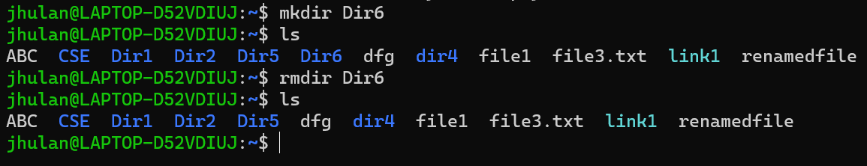
rmdir it helps to remove directory(EMPTY)

Slide 10
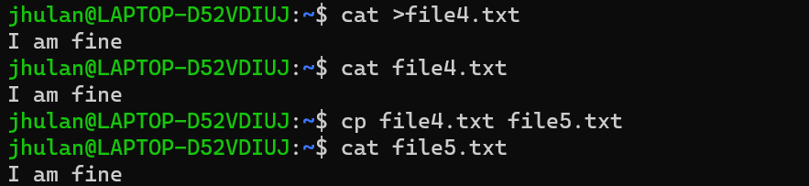
cp copy file and directory

Slide 11
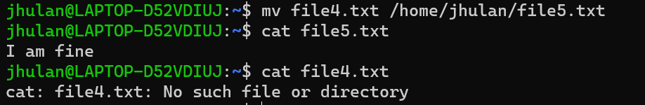
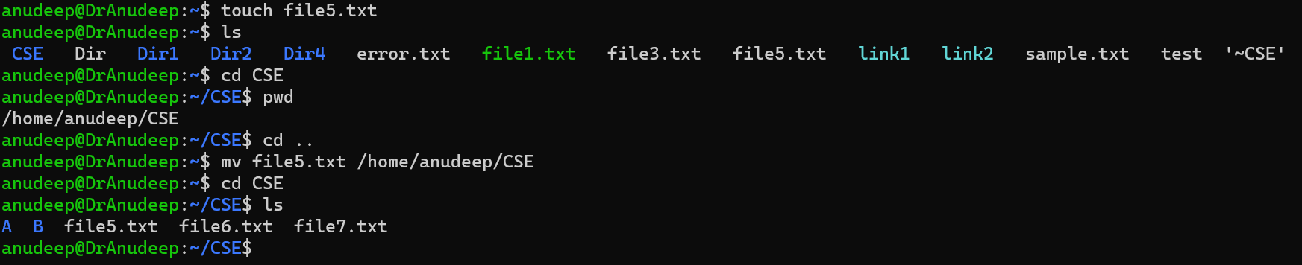
Mv command for moving

Slide 12
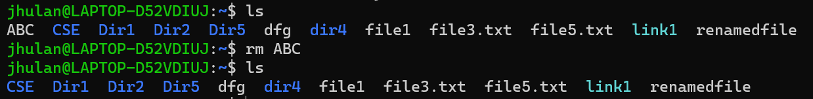
rm it removes files in directory

Slide 13
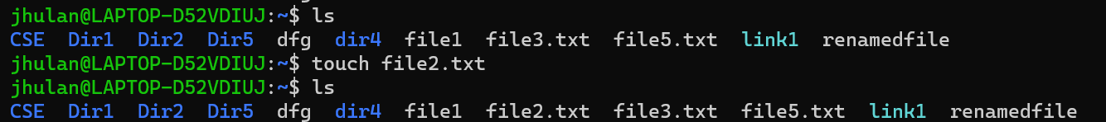
Touch creates an empty file

Slide 14
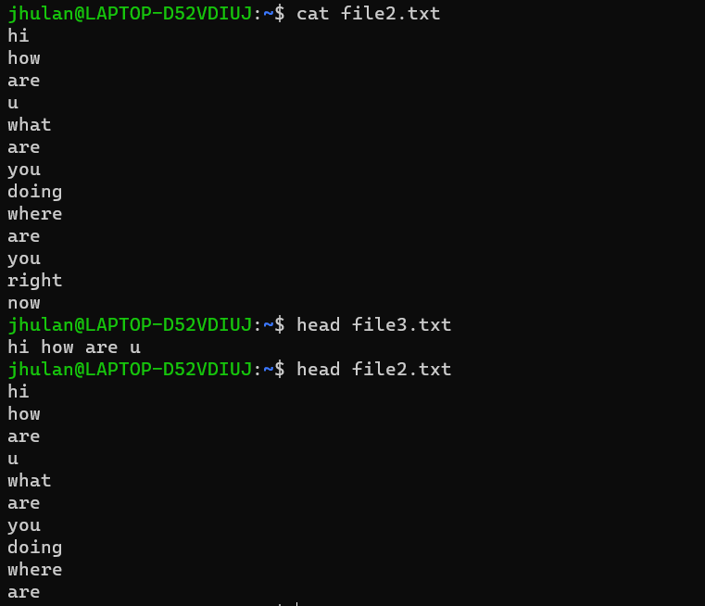
Head :Display the first ten lines

Slide 15
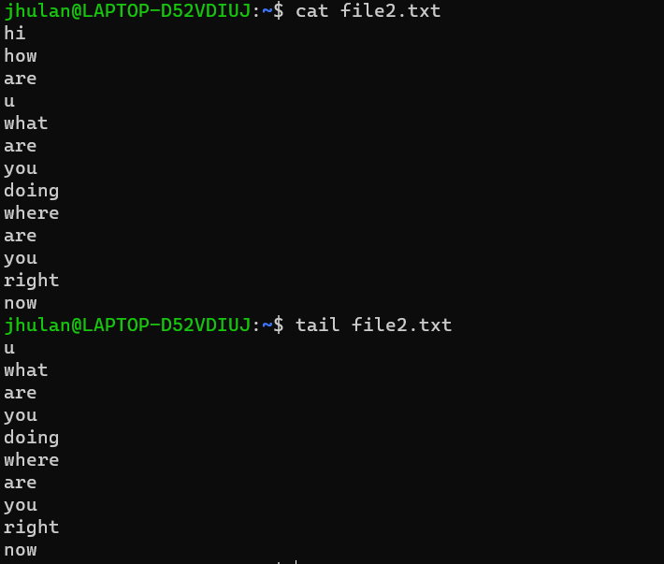
Tail: display last ten lines of any file

Slide 16
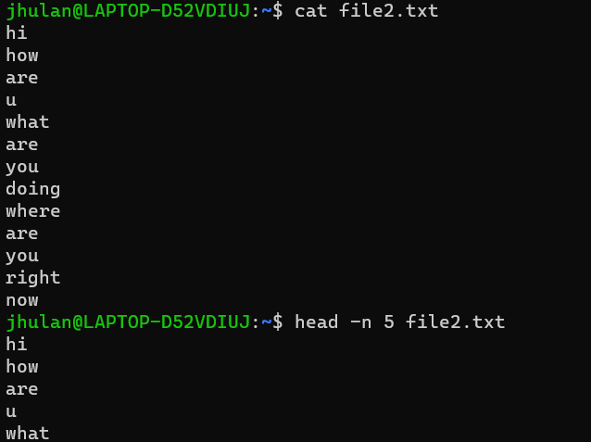
Head :Display the first 5 lines

Slide 17
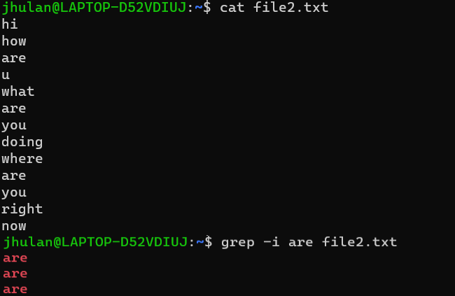
Grep: search text in file

Slide 18
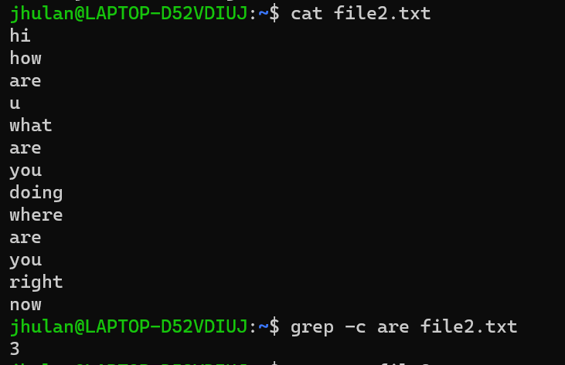
Grep: use to count word in a file

Slide 19
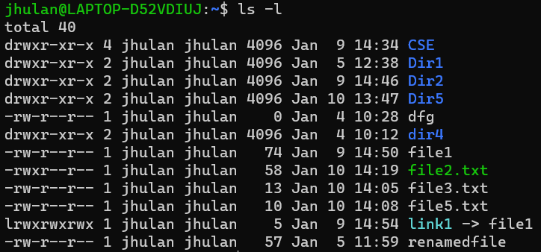
chmod: Change mode

Slide 20
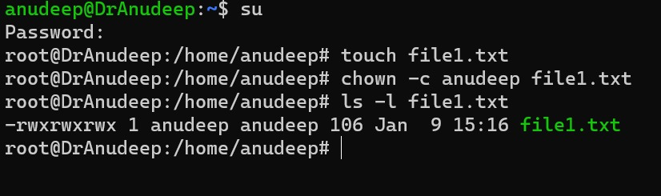
chown:Change ownership

Slide 21
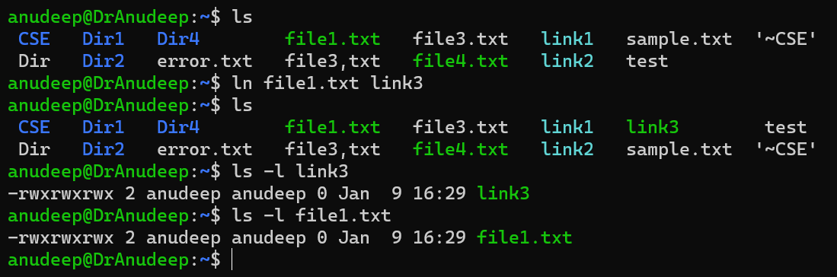
ln.-links between files

